Slide 1
ML Excursion
Demographic Data
Dylan Albrecht
Data Scientist @ CDK Global
April 19th, 2018

Slide 2
What and Why
Census data online: factfinder.census.gov/
Many datasets (financial, housing, ethnicity, …)
Clustering zip codes (zcta5 data via demographic data)
Zip Code Tabulation Area (5-digit)
Which are similar?
Unconstrained by distance
Goal: extract and view ‘zip code’ level groups and their standout attributes
Why: I hesitate to suggest

Slide 3

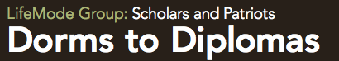
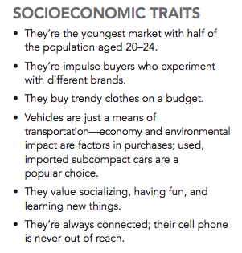
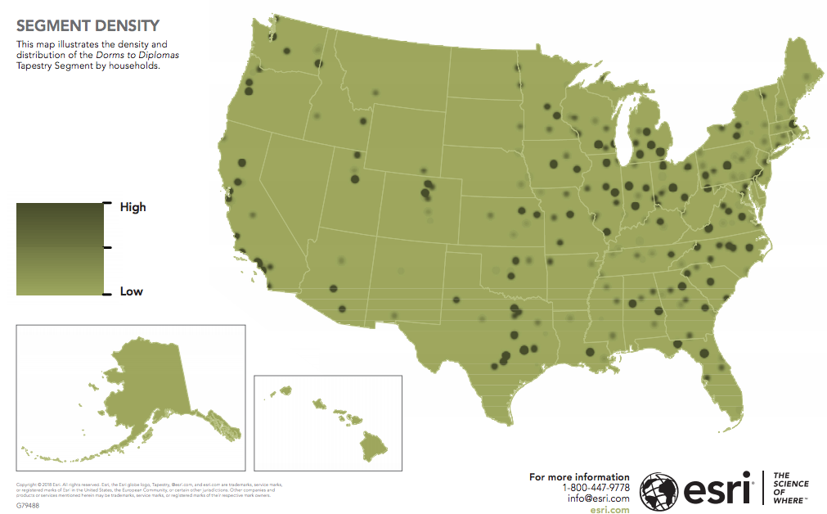

Slide 4
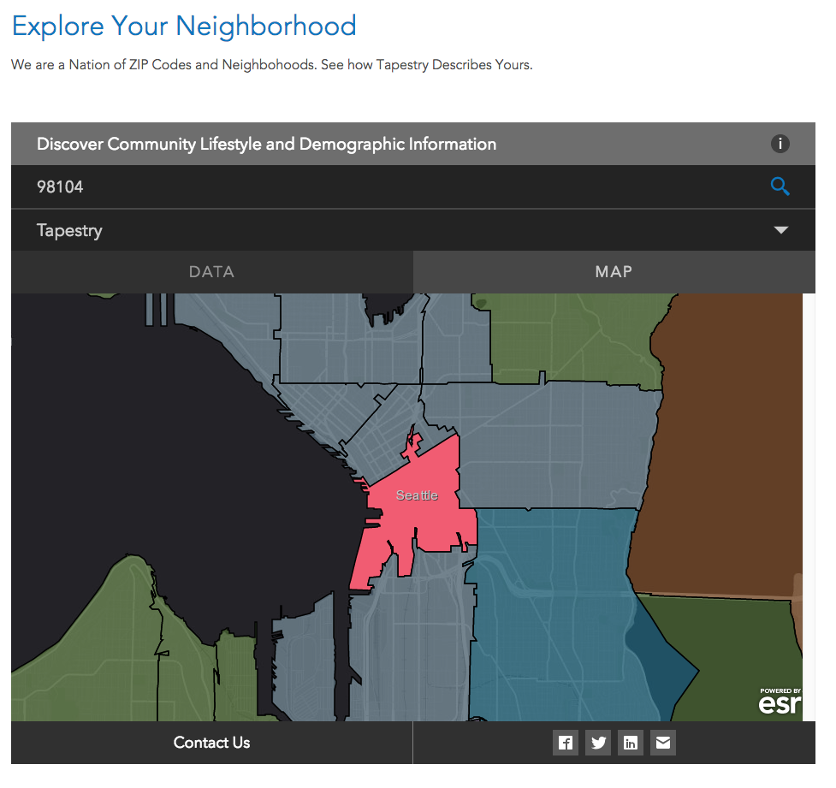


Slide 5
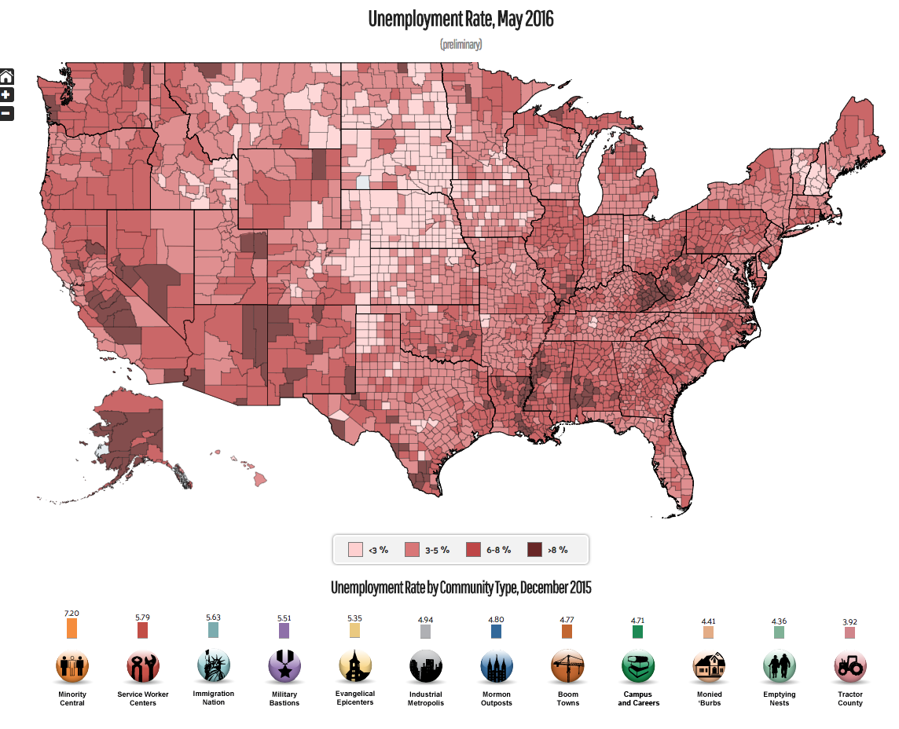
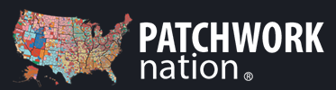

Slide 6
And because
In part to
Provide an example of how I typically use Python
Provide a glimpse of the road to production in one specific situation
You have a variety of backgrounds
Python is used in many ways

Slide 7
Workflows Cartoon
External
Internal
Data source
Model(s)
App
End goal app: Display zip clusters; visually appealing; and easily navigable

Slide 8
ZCTA5 Demographic Data Analysis
ACS_DEMOGRAPHIC_AND_HOUSING_ESTIMATES (2016; 5 year)
‘zip code’ level demographic data
~300 features
~33K zip codes
Segment using matrix factorization -- Archetypal Analysis.
Deploy interactive app

Slide 9
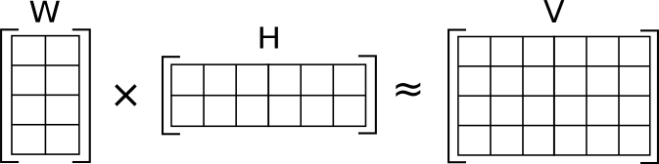
Matrix Factorization
Data Matrix

Slide 10
Matrix Factorization
Data Matrix
Zip codes
Zip codes

Slide 11
Matrix Factorization
Demographic Features
Data Matrix
Zip codes
Zip codes

Slide 12
Matrix Factorization
Demographic Features
Data Matrix
Zip codes
Zip codes
Archetypes
Elements of the arrays are numerical scores relating zip codes to archetypes

Slide 13
Archetypal Analysis
‘Archetypes’ lie on boundary of convex hull
Identifies extremes (‘pure types’)
Archetype 2
Archetype 0
Data
Archetype 1

Slide 14
Excursion

Slide 15
App
App code:
Dash (Plotly)
Model outputs
Container
Data Files

